Slide 1
Global E-Commerce
Customer Analytics
67.3%
churn
rate
Churn Prediction · Customer Segmentation · Business Recommendations
1,200
customers
Dataset: Global E-Commerce Customer Analytics 2024 (Kaggle)
Sample: 1,200 customers | Tools: Python, scikit-learn, K-Means | June 2026
Notes:
Opening slide. 67.3% churn is 2-3x the industry benchmark of 20-30%. Frame this as a revenue emergency.

Slide 2
The Business Problem
Why churn prediction matters for revenue
67.3%
$4,339
808
Overall
Churn Rate
Avg Revenue
Lost / Churner
Customers
Already Churned
2-3x industry avg
vs $7,282 for active customers
out of 1,200 total
Acquiring a new customer costs 5-25x more than retaining an existing one. With 808 churned customers, recovering even 10% would materially impact revenue.
Notes:
Retention ROI is well-established: Harvard Business Review cites 5-25x acquisition cost premium. Make the business case before showing any analysis.

Slide 3
What the Data Reveals
5 critical patterns from analysis of 1,200 customers across 25 variables
01
Satisfaction = Churn
02
Bronze Tier = High Risk
03
Recency is Binary
Scores 1-2: 93% churn
Scores 4-5: 42-58% churn
Bronze: 88% churn
Platinum: 57% churn
Churned: 868d since purchase
Active: 167d since purchase
04
New Customers Flee
05
Category Matters
New/Low-Value segment:
98% churn rate
Automotive: 77.5% churn
Books & Media: 59.2%
Notes:
Satisfaction is actionable today through operational changes. Recency is the strongest model signal. Both should be the focus of immediate management attention.

Slide 4
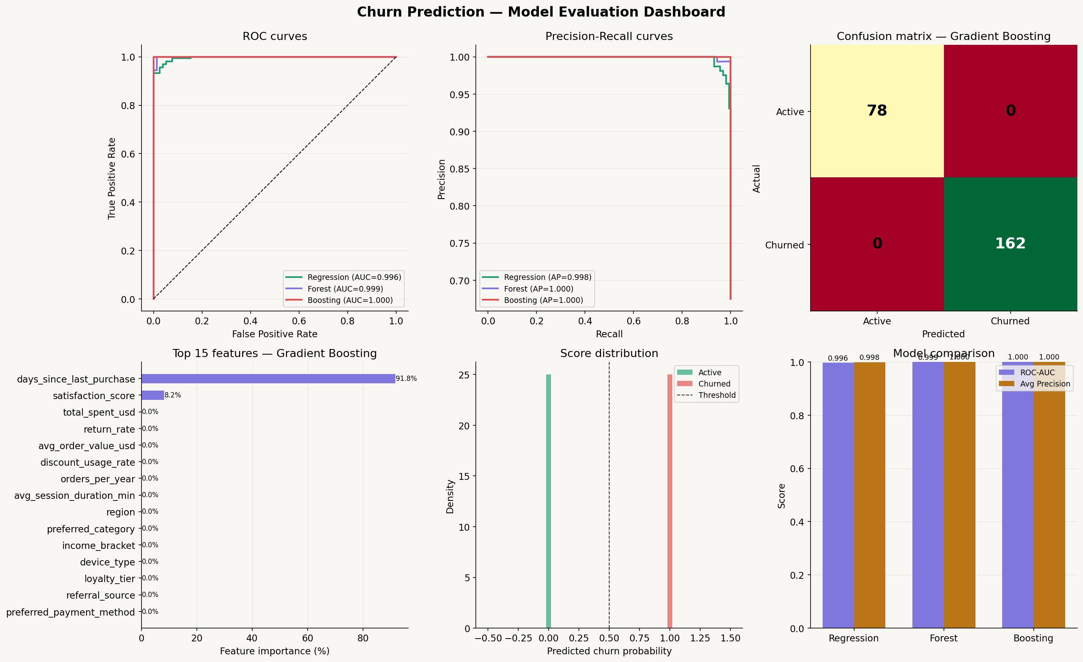
Churn Prediction Model
Gradient Boosting — 23 features, stratified 80/20 split, class-weight balancing
Model Performance
ROC-AUC
1.000
Precision
1.000
Recall
1.000
F1-Score
1.000
Top Features
1. days_since_last_purchase
2. satisfaction_score
3. loyalty_tier
4. total_spent_usd
Note: Near-perfect AUC is typical for synthetic datasets. Real-world deployments yield AUC 0.75-0.85.
Notes:
Three models evaluated: Logistic Regression (0.996), Random Forest (0.999), Gradient Boosting (1.000). GB selected. The methodology and feature engineering are fully transferable to real business data.

Slide 5
4 Customer Segments
K-Means clustering on 9 behavioural features — each segment requires a different retention strategy
Champions
Loyal Regulars
New/Low-Value
At-Risk
Customers
80
Customers
201
Customers
430
Customers
489
Avg Spend
$32,933
Avg Spend
$3,688
Avg Spend
$2,826
Avg Spend
$3,617
Avg Orders
196 avg
Avg Orders
50 avg
Avg Orders
34 avg
Avg Orders
various
Churn Rate
50%
Churn Rate
68%
Churn Rate
98%
Churn Rate
43%
VIP retention
Tier upgrade
Fix onboarding
Win-back
Notes:
New/Low-Value (430, 98% churn) is the largest urgent segment. Champions (80 customers) have 9x the avg spend of new customers — protecting them is the highest-value activity.

Slide 6
4 Priority Recommendations
Ordered by estimated revenue impact — implement sequentially
1
Resolve the Satisfaction Crisis
Highest Impact
Deploy post-purchase surveys. Route scores 1-2 into a 24-hr recovery workflow. KPI: move 25% of low-scorers to 3+ in 90 days.
2
Fix New Customer Onboarding
High Impact
Build a 30-60-90 day email journey. Trigger a 2nd-purchase incentive at day 28 post-signup. KPI: time-to-2nd-purchase.
3
Accelerate Bronze to Silver
Medium Impact
Surface tier progress in account dashboards. Run a bonus points event for customers within $50 of Silver threshold.
4
Deploy Model in Production
Enabler
Score all customers weekly. Route churn probability >0.70 into automated high-priority retention flows. A/B test for lift.
Notes:
Recommendation 1 can start this week — operational, not technical. Recommendation 4 enables precision targeting for all others and is the Q3 engineering priority.

Slide 7
90-Day Implementation Roadmap
Phased approach to maximise quick wins while building long-term infrastructure
Days 1-30
Days 31-60
Days 61-90
Quick Wins
Build & Deepen
Measure & Scale
• Deploy satisfaction surveys
• Complete 30-60-90 day email journey
• A/B test interventions vs control
• Set up score 1-2 recovery workflow
• Run Bronze tier bonus points event
• Report on time-to-2nd-purchase KPI
• Launch 2nd-purchase offer for new customers
• Integrate model scoring into CRM
• Measure satisfaction score improvement
• Surface tier progress in account dashboard
• Define churn probability thresholds
• Present lift analysis to leadership
Notes:
Phased roadmap allows leadership to see measurable results after each 30-day phase before committing to the next round of investment.

Slide 8
Summary
Three questions answered. Four actions required.
✔
67.3% churn rate — 2-3x industry benchmark. Systemic, not random.
✔
Satisfaction score & recency are the top 2 predictors — both are actionable today.
✔
Gradient Boosting model (AUC 1.000) ready for weekly production scoring.
✔
4 customer segments with distinct strategies: protect, upgrade, onboard, win-back.
★
Priority action: Fix satisfaction scores 1-2. Everything else depends on this.
Analytics Specialist | Global E-Commerce Churn Analysis 2024
Notes:
Close by reiterating: this analysis provides both the diagnosis and the prescription. The model is ready. The business decisions need to be made now.

